Slide 1
Introduction to GCSE Citizenship

Slide 2
What is citizenship education?
(Topic / aims)

Slide 3
Feedback
What is citizenship education?

Slide 4
Purpose of study
A high-quality citizenship education helps to provide pupils with knowledge, skills and understanding to prepare them to play a full and active part in society. In particular, citizenship education should foster pupils’ keen awareness and understanding of democracy, government and how laws are made and upheld. Teaching should equip pupils with the skills and knowledge to explore political and social issues critically, to weigh evidence, debate and make reasoned arguments. It should also prepare pupils to take their place in society as responsible citizens, manage their money well and make sound financial decisions.

Slide 5
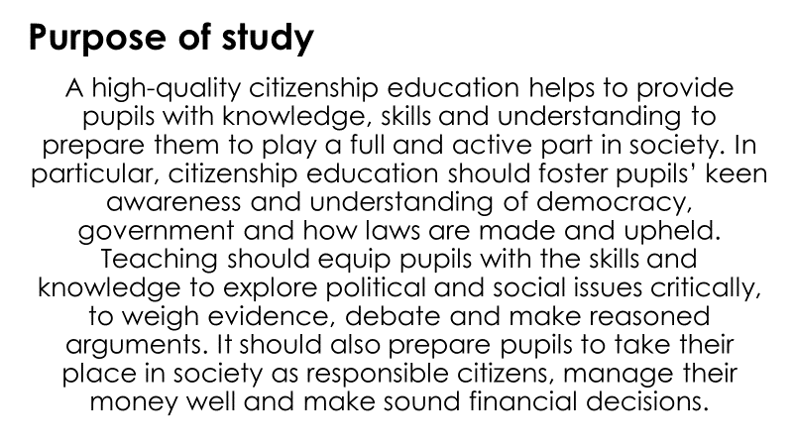
Tweet it!
In your groups, summarise the purpose of study in a tweet of 30 words or less.
You can then create 3 hashtags to promote the subject.
Be ready to feedback.

Slide 6
Aims
Acquire a sound knowledge and understanding of how the United Kingdom is governed, its political system and how citizens participate actively in its democratic systems of government
Develop a sound knowledge and understanding of the role of law and the justice system in our society and how laws are shaped and enforced
Develop an interest in, and commitment to, participation in volunteering as well as other forms of responsible activity, that they will take with them into adulthood
Are equipped with the skills to think critically and debate political questions, to enable them to manage their money on a day-to-day basis, and plan for future financial needs

Slide 7
Citizenship is a great subject to study, however…
Citizenship is not PSHE!
Citizenship isn’t a ‘doss’ subject!
You will need to do lots of extended writing in citizenship!

Slide 8
I became a citizenship teacher because…

Slide 9
I chose to study citizenship because…
Explain your reason and stick on the board.
Please write your name so I know it’s you!
(I wont read your name out)
Notes:
These can be kept by the teacher as a good way to see what students are interested in. Can inform curriculum moving forward, especially for CEIAG.

Slide 10
Themes we will study:
A: Living together in the UK
B: Democracy in the UK
C: Law & justice
D: Power & influence
E: Taking citizenship action
Initial thoughts?

Slide 11
You will sit 2 exams in year 11, these are normally at the end of exam season.
Paper 1 covers A,D and C, paper 2 covers mainly D and E (there is some cross over)
Each exam is 1 hour and 45 minutes long.
Each exam includes a section of short answer and long/essay style answer questions.
The exam will include source questions.
You will be expected to have an understanding of current events and current events will be referred to within the exam questions.

Slide 12
Who follows the news?
This is vital for citizenship.
It’s a good idea to follow a range of media providers (because they will have biases)
If you have a smart phone, download a couple of news apps
Watch the news at least twice a week
Follow news sites on social media

Slide 13
Notes:
Physically show students online apps they could be encouraged to use

Slide 14
Notes:
Physically show students accounts on twitter and Instagram they could follow to learn more about citizenship

Slide 15
As a part of your GCSE course you will be expected to work in a group to research, plan and carry out citizenship action.
This could be:
Raising awareness of a citizenship issue
Raising money for a citizenship cause
Educating others about a citizenship issue
Forming a pressure group to change something in your school or local area
The choice is yours!

Slide 16
What’s going on in the world at the moment that you wish you could change?
How could you change it?
Do you think change is possible?
Discuss in groups
Be ready to feedback

Slide 17
Any questions so far?

Slide 18
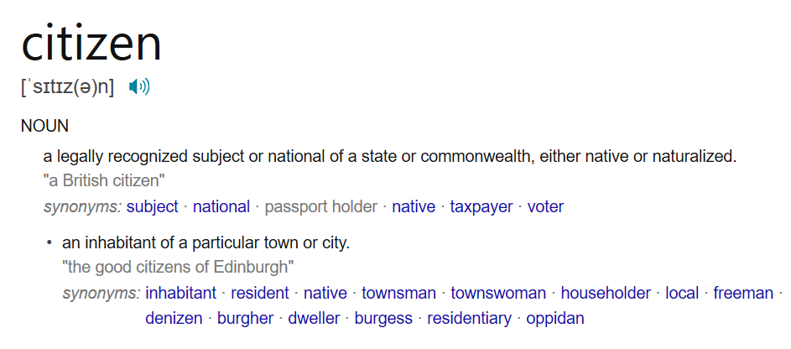
What does the word citizen mean?
What is a citizen?

Slide 19
Get into small groups
As a group, you will have time to create two citizens
One will be an absolute model citizen!
The other will a terrible citizen!
Each group will then present their citizens to the class.
You can be as creative as you wish!

Slide 20
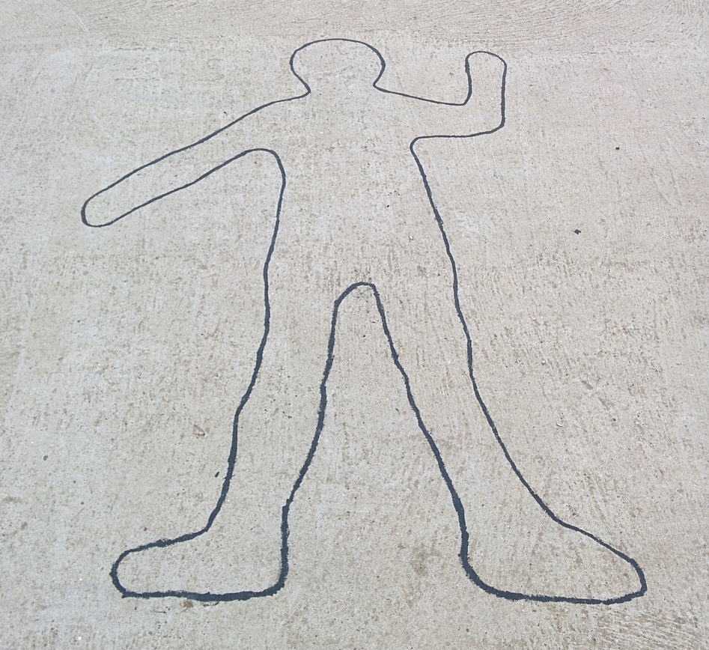
Worlds best citizen…
Create a perfect citizen, consider:
How would they behave?
What would they do?
What would they not do?
Keep it citizenship! (Think back to the purpose and aims)

Slide 21
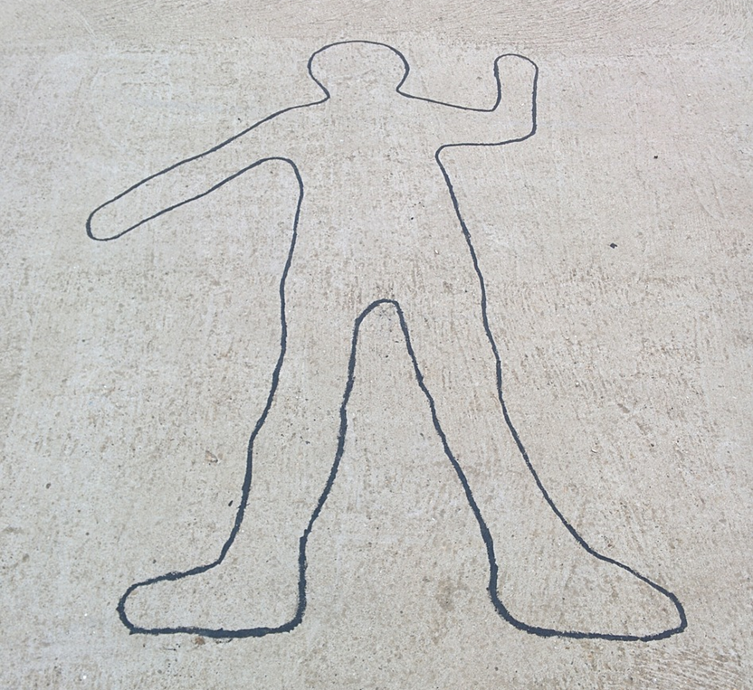
Worlds worst citizen…
How would they behave?
What would they do?
What would they not do?
Keep it citizenship! (Think back to the purpose and aims)

Slide 22
Independent work – Model citizen
In your work book, write a mini essay explaining the responsibilities of a model citizen.
Use the picture prompts to help you.
Ensure you explain why the behaviours / actions you are writing about are so important.

