Slide 1
Is there an afterlife?
RE learning objective: Explore Christian views towards an afterlife.
Global Learning Objective: Develop my understanding of how my actions and the actions of others have a global impact.
Outcomes:
To consider Christian views towards an afterlife
To consider my own views and the views of others
To review my choices
To consider the impact of my actions and the actions of others

Slide 2
Discuss with the
person next
to you (3 mins)
Is there an
afterlife?
Think about
It (2 mins)
Class feedback: Remember, it is important we respect the views of others, even if they are different to our own.
Notes:
Thin, pair, share

Slide 3
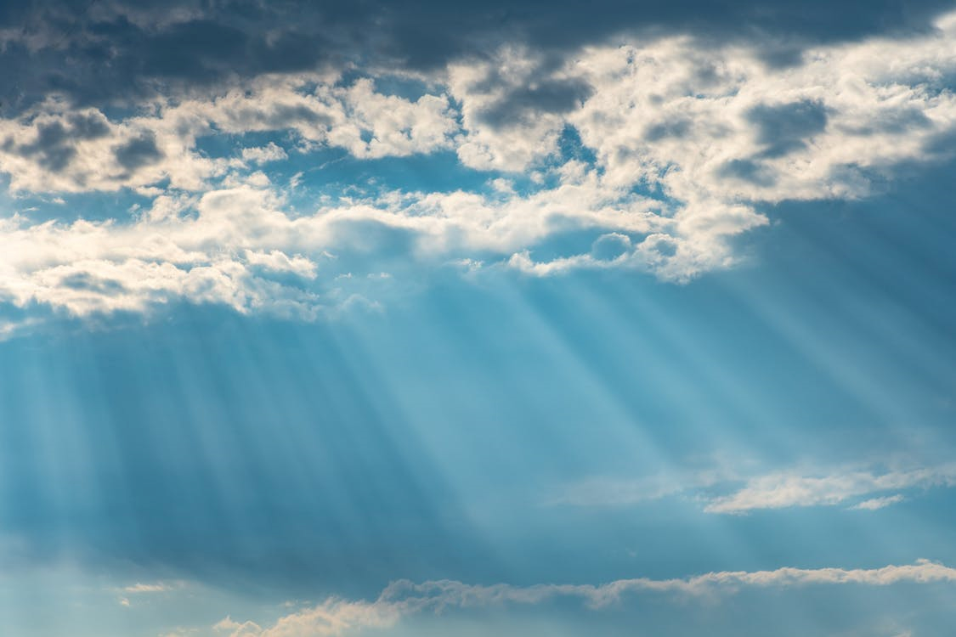
Religious perspective
Many people believe that after death, they will taken into the presence of God and they will be judged for the deeds they have done in their lifetime. This judgment will either lead to heaven or hell.
Notes:
Students can discuss whether they believe in the concept of heaven and hell

Slide 4
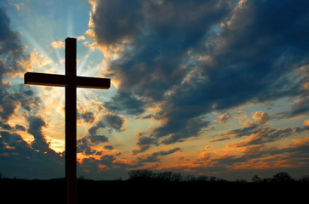
"But when the Son of Man comes in his glory, and all the holy angels with him, then he will sit on the throne of his glory. Before him all the nations will be gathered, and he will separate them one from another, as a shepherd separates the sheep from the goats. He will set the sheep on his right hand, but the goats on the left. Then the King will tell those on his right hand, ‘Come, blessed of my Father, inherit the Kingdom prepared for you from the foundation of the world; for I was hungry, and you gave me food to eat. I was thirsty, and you gave me drink. I was a stranger, and you took me in. I was naked, and you clothed me. I was sick, and you visited me. I was in prison, and you came to me.’
“Then the righteous will answer him, saying, ‘Lord, when did we see you hungry, and feed you; or thirsty, and give you a drink? When did we see you as a stranger, and take you in; or naked, and clothe you? When did we see you sick, or in prison, and come to you?’
“The King will answer them, ‘Most certainly I tell you, because you did it to one of the least of these my brothers, you did it to me.’ Then he will say also to those on the left hand, ‘Depart from me, you cursed, into the eternal fire which is prepared for the devil and his angels; for I was hungry, and you didn’t give me food to eat; I was thirsty, and you gave me no drink; I was a stranger, and you didn’t take me in; naked, and you didn’t clothe me; sick, and in prison, and you didn’t visit me.’
“Then they will also answer, saying, ‘Lord, when did we see you hungry, or thirsty, or a stranger, or naked, or sick, or in prison, and didn’t help you?’
“Then he will answer them, saying, ‘Most certainly I tell you, because you didn’t do it to one of the least of these, you didn’t do it to me.’ These will go away into eternal punishment, but the righteous into eternal life.”
Read through this parable, what do you think it means?
Discuss with your partner.

Slide 5
"But when the Son of Man comes in his glory, and all the holy angels with him, then he will sit on the throne of his glory. Before him all the nations will be gathered, and he will separate them one from another, as a shepherd separates the sheep from the goats. He will set the sheep on his right hand, but the goats on the left. Then the King will tell those on his right hand, ‘Come, blessed of my Father, inherit the Kingdom prepared for you from the foundation of the world; for I was hungry, and you gave me food to eat. I was thirsty, and you gave me drink. I was a stranger, and you took me in. I was naked, and you clothed me. I was sick, and you visited me. I was in prison, and you came to me.’
“Then the righteous will answer him, saying, ‘Lord, when did we see you hungry, and feed you; or thirsty, and give you a drink? When did we see you as a stranger, and take you in; or naked, and clothe you? When did we see you sick, or in prison, and come to you?’
“The King will answer them, ‘Most certainly I tell you, because you did it to one of the least of these my brothers, you did it to me.’ Then he will say also to those on the left hand, ‘Depart from me, you cursed, into the eternal fire which is prepared for the devil and his angels; for I was hungry, and you didn’t give me food to eat; I was thirsty, and you gave me no drink; I was a stranger, and you didn’t take me in; naked, and you didn’t clothe me; sick, and in prison, and you didn’t visit me.’
“Then they will also answer, saying, ‘Lord, when did we see you hungry, or thirsty, or a stranger, or naked, or sick, or in prison, and didn’t help you?’
“Then he will answer them, saying, ‘Most certainly I tell you, because you didn’t do it to one of the least of these, you didn’t do it to me.’ These will go away into eternal punishment, but the righteous into eternal life.”
Notes:
Printed for students to read independently.

Slide 6
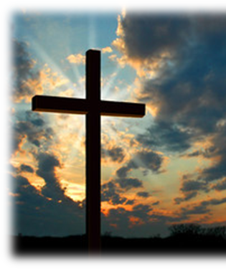
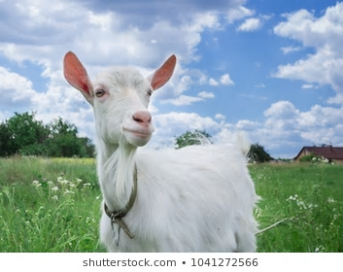
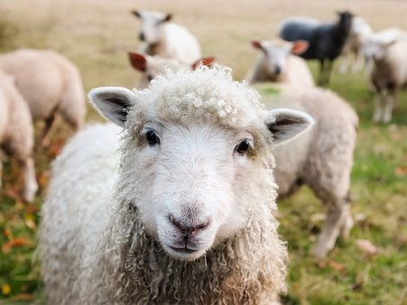
"But when the Son of Man comes in his glory, and all the holy angels with him, then he will sit on the throne of his glory. Before him all the nations will be gathered, and he will separate them one from another, as a shepherd separates the sheep from the goats. He will set the sheep on his right hand, but the goats on the left. Then the King will tell those on his right hand, ‘Come, blessed of my Father, inherit the Kingdom prepared for you from the foundation of the world; for I was hungry, and you gave me food to eat. I was thirsty, and you gave me drink. I was a stranger, and you took me in. I was naked, and you clothed me. I was sick, and you visited me. I was in prison, and you came to me.’
“Then the righteous will answer him, saying, ‘Lord, when did we see you hungry, and feed you; or thirsty, and give you a drink? When did we see you as a stranger, and take you in; or naked, and clothe you? When did we see you sick, or in prison, and come to you?’
“The King will answer them, ‘Most certainly I tell you, because you did it to one of the least of these my brothers, you did it to me.’ Then he will say also to those on the left hand, ‘Depart from me, you cursed, into the eternal fire which is prepared for the devil and his angels; for I was hungry, and you didn’t give me food to eat; I was thirsty, and you gave me no drink; I was a stranger, and you didn’t take me in; naked, and you didn’t clothe me; sick, and in prison, and you didn’t visit me.’
“Then they will also answer, saying, ‘Lord, when did we see you hungry, or thirsty, or a stranger, or naked, or sick, or in prison, and didn’t help you?’
“Then he will answer them, saying, ‘Most certainly I tell you, because you didn’t do it to one of the least of these, you didn’t do it to me.’ These will go away into eternal punishment, but the righteous into eternal life.”
What do you think it means?
Feedback!

Slide 7
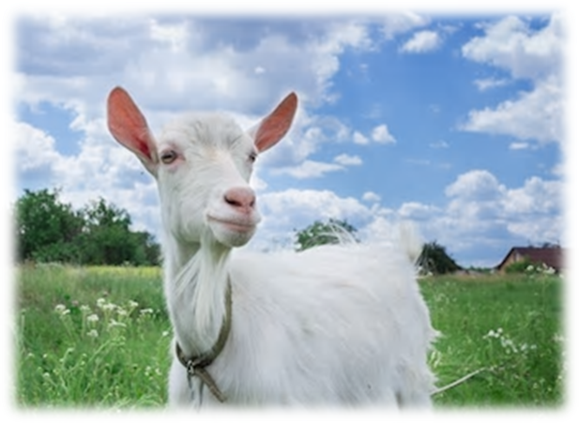
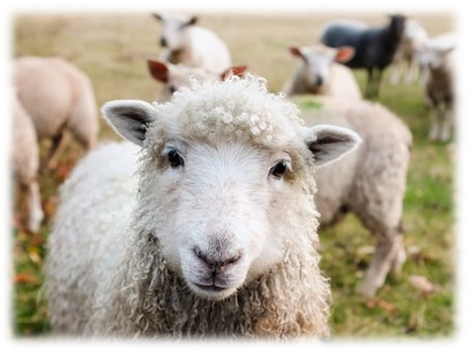
The Sheep and the Goats – Matthew’s Gospel
This bible passage raises a very common question, asked and debated by humans for many, many years.
Who goes to heaven and why?
Some people believe that on judgement day, we are separated (as a shepherd separates sheep and goats)
Those people who have lived their lives, helping each other and doing the right thing in the name of God will go to heaven. Those who have done the opposite will go to hell.
Notes:
Discuss with students, do they agree?

Slide 8
Sheep or Goat?
 | Initial thoughts | Developed thoughts | Final thoughts
1
2
3
4
5
6
7
You will now be introduced to 7 different people. You will be given 3 pieces of information about each of them. At each stage you will need to decide if they are a sheep (good, deserving of heaven) or a goat (bad, undeserving of heaven) We will discuss as a whole class once we have finished, so be ready to feedback.

Slide 9
Sheep or Goat?
 | Initial thoughts | Developed thoughts | Final thoughts
1
2
3
4
5
6
7
Notes:
A4 print for each student

Slide 10
Initial thoughts
Are they a sheep or a goat? | 1. This person has just been arrested by the police | 2. This person loves to take their family on holiday | 3. This person has been caught stealing from a shop
4. This person looks after his wife | 5. This person is a surgeon | 6. This person is a news reporter | 7. This person has opened a cheap clothes shop in the UK
Notes:
Can either be printed or shown on whiteboard

Slide 11
Developed thoughts
Has your opinion changed? | 1. This person has just been arrested by the police, they were taking part in a protest against global Human Rights abuses | 2. This person loves to take their family on holiday, they are very rich so like to use their private jet | 3. This person has been caught stealing from a shop, they have stolen a loaf of bread and pack of bananas
4. This person looks after his wife, he makes sure she never has to work or make any difficult decisions | 5. This person is a surgeon, they work in a very expensive clinic performing plastic surgery | 6. This person is a news reporter, they often make people angry as they like to uncover secrets | 7. This person has opened a cheap clothes shop in the UK, they have opened it in an area of low income so that the citizens can afford to shop there
Notes:
Can either be printed or shown on whiteboard

Slide 12
Final thoughts
Has your opinion changed? | 1. This person has just been arrested by the police, they were taking part in a protest against global Human Rights abuses. They assaulted a police officer who was trying to break the protest up. | 2. This person loves to take their family on holiday, they are very rich so like to use their private jet, this means they have a huge carbon footprint. | 3. This person has been caught stealing from a shop, they have stolen a loaf of bread and pack of bananas to feed their children as they have no money.
4. This person looks after his wife, he makes sure she never has to work or make any difficult decisions. He does not let her leave the house by herself. | 5. This person is a surgeon, they work in a very expensive clinic performing plastic surgery, they are saving money so they can travel to Uganda to carry out aid work. | 6. This person is a news reporter, they often make people angry as they like to uncover secrets, they recently uncovered a news story about a company that was paying men more than women. | 7. This person has opened a cheap clothes shop in the UK, they have opened it in an area of low income so that the citizens can afford to shop there. They keep costs down by basing factories in Bangladesh so they can pay workers less than the UK.
Notes:
Can either be printed or shown on whiteboard

Slide 13
Group work. Where would you rank each person? Write the number on the line.
Notes:
A3 printed. One per group.

Slide 14
Group work. Where would you rank each person? Write the number on the line.

Slide 15
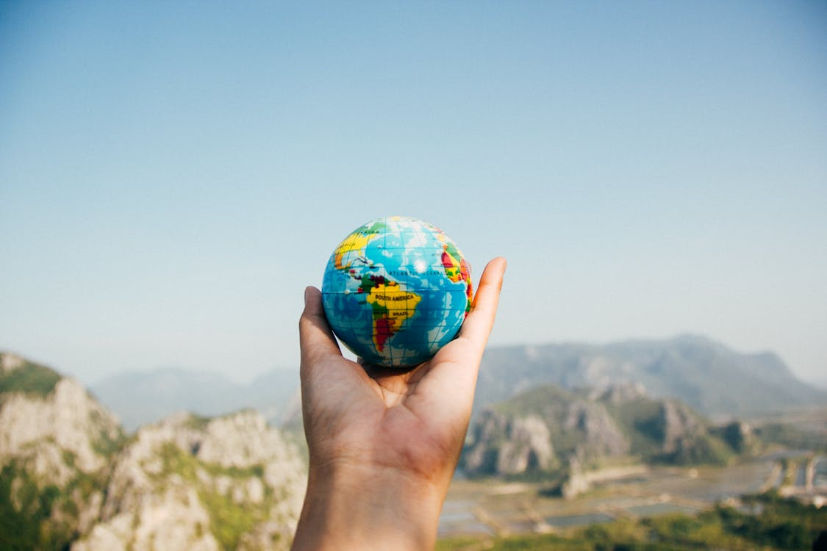
The information you received about these people, introduced you to global learning themes. Our actions and the decisions we make can have a positive or negative global impact.
Notes:
Hyperlinked.

Slide 16
Hopefully, as you go through life, you will strive to do the right thing and help others, this may be in the name of God or it may not.
How do you help others?
How might you help others in the future?
Do you see yourself as a global citizen?
Notes:
Hyperlinked.

Slide 17
Either way, dong the right thing as a global citizen is not always easy. For your final reflection you are going to pick one theme from this lesson and make three pledges…
Notes:
Hyperlinked.

Slide 18
Helping those less fortunate
Reducing your carbon footprint
Being an informed citizen
Supporting equality
Pick one theme to form your pledges
Protesting
Notes:
Support students with picking a theme that they understand and can link to their own lives.

Slide 19
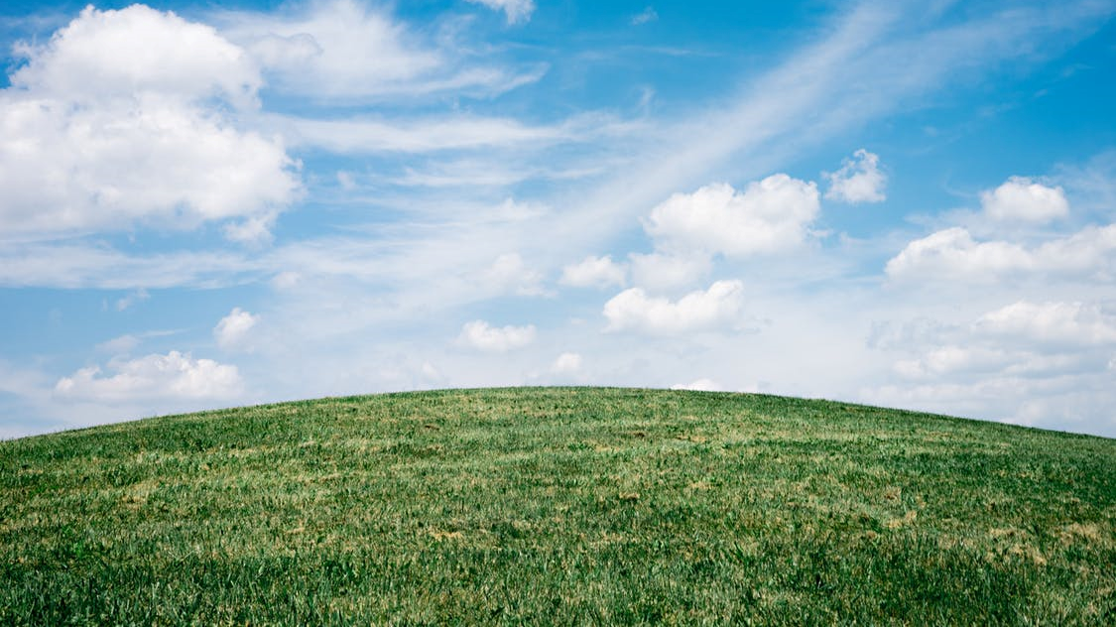
My chosen theme:
Pledge 1:
Pledge 2:
Pledge 3:
Notes:
Print A4 colour. Students identify a theme e.g. supporting equality, then think of three things they can pledge that will help them e.g. not making assumptions based on gender.

