Slide 1
Would you…
Get into a car with a stranger?
Go to a party where you didn’t know the host?
Lie for a friend?
Change your style to try and impress someone?
Lie to your parents/guardians about where you were going?
Add someone you don’t know on social media?
Drink from a bottle that was offered to you at a party?
Chat to strangers? (in a social situation)
Take a drag from a roll up that was offered to you at a party?
Enter a romantic relationship with someone who was older than you?
Trust your ‘instincts’ in a new situation?

Slide 2
Scenario:
When/why might this happen?
Why might this be ok?
Why might this not be ok?
Worst case scenario:
So?

Slide 3
Intimidate
Trust
Abuse
Power
Initiate
Love
Enforce
Initiate
Online
X-rated
Tricked
NSPCC
Older

Slide 4
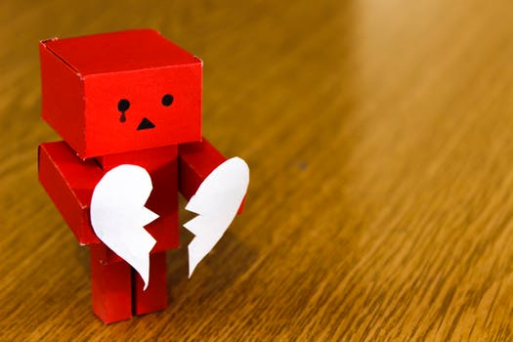
Exploitation
Young person is targeted and contact is made. Abuser will try to find someone who is willing to take risks.
Friendship is formed. Trust is gained. Young person may receive gifts, be told that the abuser ‘is the only one that really understands them’.
Young person believes they are in a loving relationship. Often very intense, other relationships are pushed to the side.
Abuse stage. Young person pressured into doing things they don’t want to, due to ‘owing’ the abuser. This could include sexual activity with other people, carrying drugs or stealing.

Slide 5
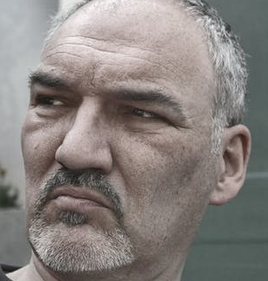

Slide 6
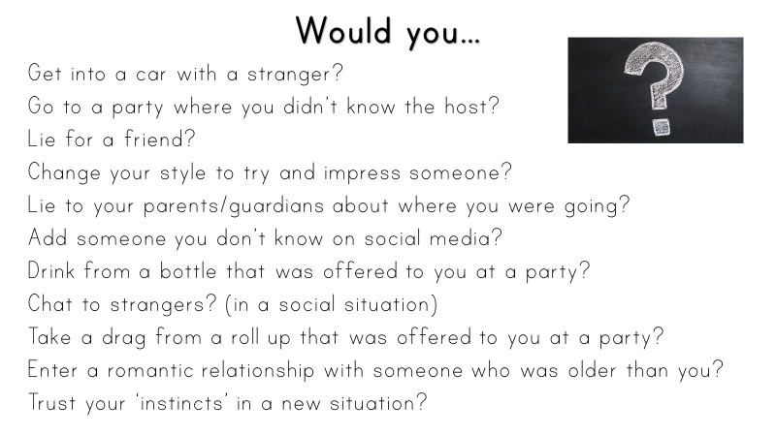

Slide 7
OK or not OK?
Encourages you to wear/not wear certain clothing | Wants to spend all their time with you | Wants to be your ‘number 1 person’
Gives you lots of gifts and/or money | Shows signs of jealousy | Is happy to give you alcohol, cigarettes and drugs
Wants you to send them sexy photos | Takes you to parties and introduces you to all their older mates | Is happy with an age gap (with them being over the age of 18)

Slide 8
See, hear, feel

Slide 9
Support

Slide 10
Teacher tips:
Slide 1 – Show each statement at a time, students state yes, no, not sure for each. This can be done via show of hands, moving around the room or verbally. There is also the option to print the slide and ask students to complete in groups as an alternative. Discuss answers but only briefly.
Slide 2 – Print out in A3. Split students into small groups, they pick a scenario from the previous slide to think about in more detail. You might allow students to make their ow choice, or you might personalise it by ensuring that students are working on scenarios that are a safeguarding concern (to an individual/school) Allow for each group to present/feedback.
Slide 3 – Students read the words, as a class you could discuss what they mean (if needed) students then need to write down the first letter from each word and try and form a separate word from these letters e,x,p,l,o,i,t,a,t,i,o,n. This term is then discussed as a group.
Slide 4 – Stages of exploitation are shared with the group. First show the pictures only, can students guess what they mean? When exploring the stages ensure students understand that this would happen over a period of time and that the abuser would encourage the person being exploited to leave behind all of their old friends/family.
Slide 5 – Ask students to work in groups to identify the person most likely to be an abuser. On reflection, ensure students understand that the initial people involved in CSE will likely be teenagers/young adults and relatively normal looking. To build trust and form a friendship, this is very important. Ensure students are aware that (although rarer) women have been involved in CSE too.
Slide 6 – Reflect on earlier activity, could any of these be warning signs to a exploitive relationship?
Slide 7 – Students discuss in groups and then as a bigger group. Assess each, when might this be OK? When could it be a warning sign? Refer back to exploitation explanation (slide 4)
Slide 8 – Students work in groups to consider what they would expect to see, hear and feel in a healthy relationship e.g. see smiles, hear laughter, feel safe. Then refer back to the exploitation explanation (slide 4) and ask students what they would expect to see, hear and feel at each stage.
Slide 9 – This has been left blank so that staff can personalise with local CSE signposting and the names of designated child protection staff in school.
I would advise that schools obtain a copy of the Sick Party DVD resource to use alongside this PowerPoint http://basistraining.org.uk/resources/

