Slide 1
Gender inequality
RE learning objective: Explore religious beliefs about the role of women.
Global Learning Objective: Develop my understanding of gender inequality at a global level.
Outcomes:
To understand different religious and legal beliefs about the role of women and inequality
To consider my own views
To consider how my actions have an impact

Slide 2
What might the negatives of being a female be?
What adjectives do you associate with the word female?
The global perspective: Do females experience life differently, depending on the country in which they live.
What might the positives of being a female be?
Notes:
Students to brainstorm, either individually or in groups

Slide 3
What might the negatives of being a male be?
What adjectives do you associate with the word male?
The global perspective: Do males experience life differently, depending on the country in which they live.
What might the positives of being a male be?
Notes:
Students to brainstorm either individually or in groups

Slide 4
Feedback
Feedback
Notes:
Feedback as a whole class, compare differences, begin to explore why there may be differences in opinion.

Slide 5
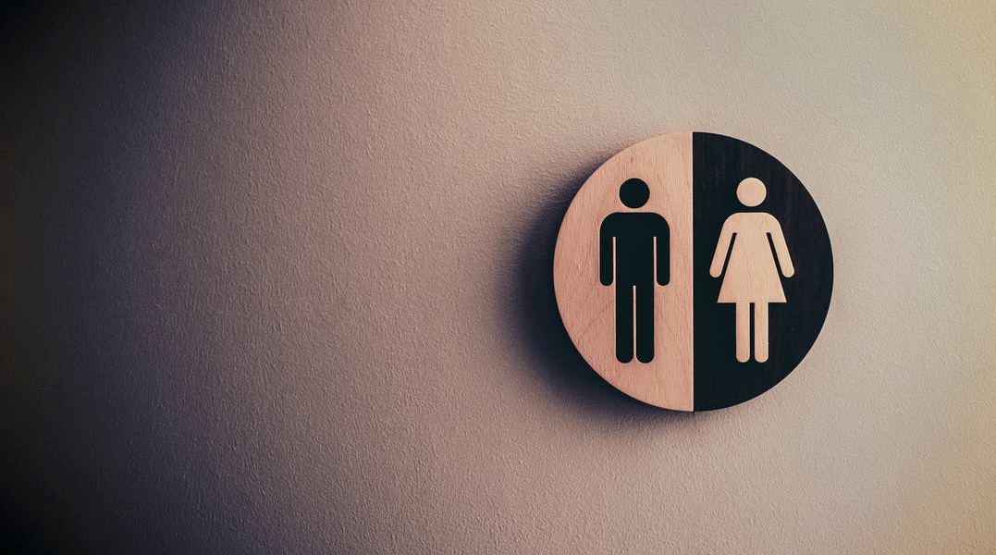
Gender inequality:
There is huge gender inequality at both a national and global level. These inequalities are found in politics, health care, education, safety and employment to name a few.
Notes:
Discuss

Slide 6
Which statistic?
Globally, 550 / 650 / 750 million women and girls were married before the age of 18
In 7 / 18 / 22 countries, husbands can legally prevent their wives from working
While women have made important inroads into political office across the world, their representation in national parliaments at 23.7% / 36.1% / 42.9% is still far from parity.
About one quarter / one third / half of developing countries have not achieved gender parity in primary education.
Worldwide, 15% / 25% / 35% per cent of women between 15-49 years of age have experienced physical and/ or sexual intimate partner violence
https://www.un.org/sustainabledevelopment/gender-equality/
Notes:
Students to guess which statistic is correct. This slide can either be printed for students to circle, or can be written in workbooks.

Slide 7
Globally, 750 million women and girls were married before the age of 18
In 18 countries, husbands can legally prevent their wives from working
While women have made important inroads into political office across the world, their representation in national parliaments at 23.7 per cent is still far from parity.
About one third of developing countries have not achieved gender parity in primary education.
Worldwide, 35 per cent of women between 15-49 years of age have experienced physical and/ or sexual intimate partner violence
How does this
make you feel?
https://www.un.org/sustainabledevelopment/gender-equality/
Notes:
Correct answers and discuss how this makes them feel.

Slide 8
Until recently, women in ***** were banned from driving
At least 1000 honour killings occur annually in both ***** and *****
One in five women on ***** college campuses have experienced sexual assault
In the *****, women can’t vote
In West and Central ***** over 40% of females are married before their 18th birthday
The Global Perspective:
Gender inequality is even more apparent when looking globally.
Can you identify the places that these statistics relate to?
Notes:
Students guess which place each statement refers to. This slide can either be printed for students to write on or they can copy in their workbooks.

Slide 9
Until recently, women in Saudi Arabia were banned from driving
At least 1000 honour killings occur annually in both India and Pakistan
One in five women on U.S. college campuses have experienced sexual assault
In the Vatican City, women can’t vote
In West and Central Africa over 40% of females are married before their 18th birthday
The Global Perspective:
Gender inequality is even more apparent when looking globally.
Can you identify the countries that these statistics relate to?
Notes:
Students correct answers

Slide 10
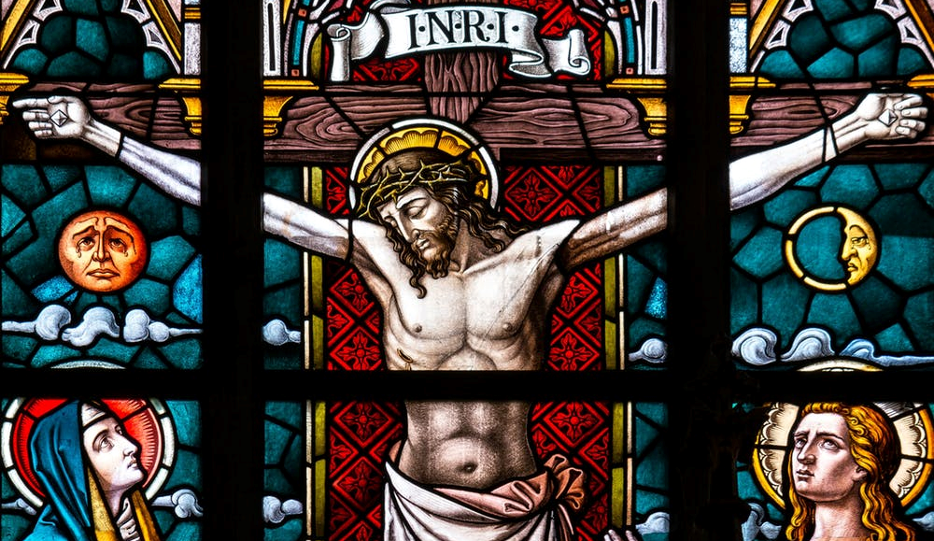
Religious perspective: Christianity
“Wives, submit to your husbands as to the Lord. For the husband is the head of the wife as Christ is the head of the church, his body, of which he is the Saviour. Now as the church submits to Christ, so also wives should submit to their husbands in everything”
St Paul's letter to the Ephesians 5:21-22
“There is neither Jew nor Greek, slave nor free, male nor female for you are all one in Christ Jesus”
St Paul's letter to the Galatians 3:28
What does this mean?
Notes:
Students to explore, what might the words mean? How might they be interpreted?

Slide 11
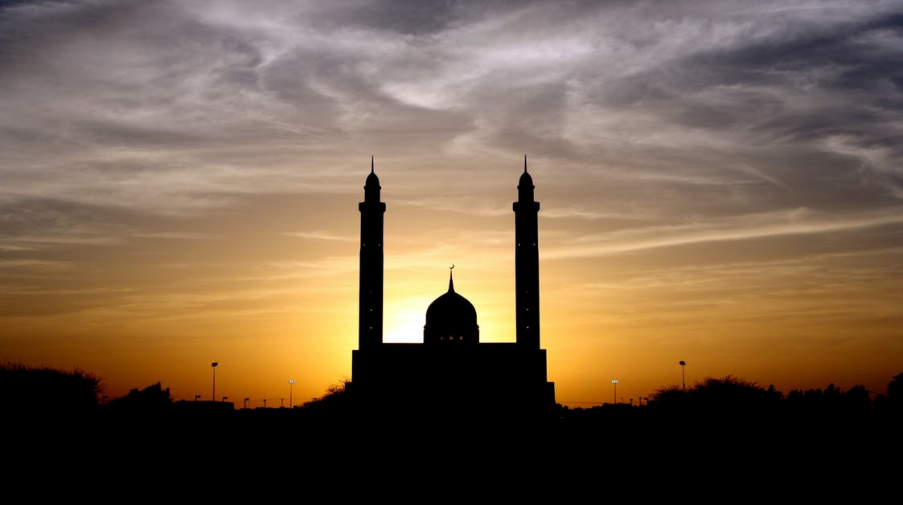
Religious perspective: Islam
“Wives have rights corresponding to those which the husbands have, in equitable reciprocity, though, in certain situations men would have the final word and would thus enjoy a preference” Surah 2:229
“Men are appointed guardians over women, because of that in respect of which Allah has made some of them excel others, and because men spend of their wealth” Surah 4:35
What does this mean?
Notes:
Students to explore, what might the words mean? How might they be interpreted?

Slide 12
The understanding that men and women should have different roles is still a belief that some Christians hold today. This is because they believe that God made men and women differently. Other Christians believe that men and women were both made in the image of God and as a result should be treated equally, with the same responsibilities and also privileges.
Islam teaches that men and women are equal in the eyes of Allah. Some Muslims believe that men and women were made differently and have different purposes. Traditionally, it is believed that it is up to the man to provide for his family financially while it is the woman’s responsibility to look after the home and family, this is the same as traditional Christian beliefs.
Notes:
Discuss

Slide 13
So, although religious scriptures may be interpreted to suggest that men and women have differing traditional roles, they also state that men and women are equal and loved in the eyes of God. Which poses the question…
Should religious leaders do more to promote gender equality?
Notes:
Pose this question to the students.

Slide 14
Human Rights perspective
All human beings are free and equal in terms of dignity and rights
Right to be treated equally by the law
Right to take part in and select a government
Right to work and equal pay for work
Right to education

Slide 15
Legal perspective (UK)
The Equality Act 2010 makes it illegal to discriminate against people due to 9 protected characteristics.
A persons gender is included as a protected characteristic.

Slide 16
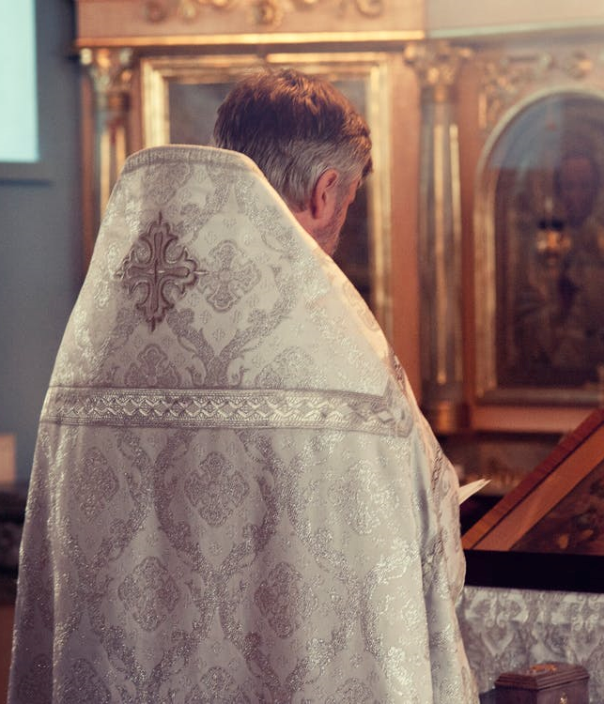
Religious leaders or political leaders?
Who is the most powerful?
How could they improve gender inequality?
What would make them successful?
What would be their challenges?
Should religious leaders do more to end gender discrimination?
Should political leaders do more to end gender discrimination?
Notes:
Students to debate in small groups. They could create a brainstorm to note their ideas or write in essay form in their workbooks.

Slide 17
What about you?
Thoughts & actions
National
Global
Notes:
A4 printed. Students to consider how they could have an impact on gender equality. E.g. thought & actions – not making presumptions about somebody die to their gender, not using terms such as ‘man up’ National – lobby my MP, discuss gender stereotypes with my school council. Global – visit sites like Amnesty International to see how I can lobby global leaders. Use https://www.un.org/sustainabledevelopment/gender-equality/ to support answers. Lots of great ideas.

Slide 18
What about you?
Thoughts & actions
National
Global

