Slide 1
The Universal Declaration of Human Rights (UDHR)
RE learning objective: To consider different Christian viewpoints towards Human Rights.
Global Learning Objective: Develop my understanding of Human Rights from an evaluative, global perspective. Consider how my actions can have an impact.
Outcomes:
To consider Christian views towards Human Rights
To consider the success/failure of the UDHR
To consider my own views and the views of others
To consider the impact of my actions and the actions of others

Slide 2
Human Rights - What do you know already?
Brainstorm in small groups
Top tip - think about the key words:
Universal
Declaration
Human
Rights
Notes:
In books or on paper, students brainstorm anything they know about Human Rights. If their knowledge is lacking they should try and define the key words.

Slide 3
What do you know already?
Brainstorm in small groups.
Top tip - think about the key words:
Universal
Declaration
Human
Rights

Slide 4
Universal
Human Rights are universal. This means they should be visible and apply to every single country in the world.

Slide 5
Declaration
A formal or explicit statement or announcement. When the UDHR was created, global leaders made a statement that they would work towards its shared goals.

Slide 6
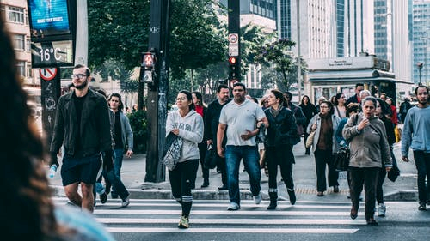
Human
Human Rights apply to every single person on the planet, simply because they are human. This should be regardless of age, sex, race, nationality or disability. They are inherited by virtue of being human.

Slide 7
Rights
Things that all humans should legally or morally have. Things they should expect so that they can lead healthy, safe and happy lives e.g. right to an education

Slide 8
Universal Declaration of Human Rights (UDHR)
An explicit global statement, that all humans, from every country in the world should be able to live a healthy, safe and happy life.
Watch the video. How does it develop your understanding of Human Rights?
Notes:
Hyperlink to 10 min video. Key message is about the fact that Human Rights are long fought and not yet universal, students will need to consider WHY they are not yet universal.

Slide 9
Why is the
UDHR not yet
fully
successful?
Discuss with the
person next
to you (3 mins)
Think about
It (2 mins)
Consider the key question. First independently, then with a partner. Be ready to feedback.
Notes:
Thin, pair, share

Slide 10
Why is the
UDHR not yet
fully
successful?
Discuss with the
person next
to you (3 mins)
Think about
It (2 mins)
Notes:
Thin, pair, share

Slide 11
Inconsistencies of the UDHR
When the UDHR was created it was a declaration, not a legal obligation.
Therefore, its success is dependant on individual governments and global partnerships.
Notes:
Link this back to the video, you may wish to play the last 3 mins again.

Slide 12
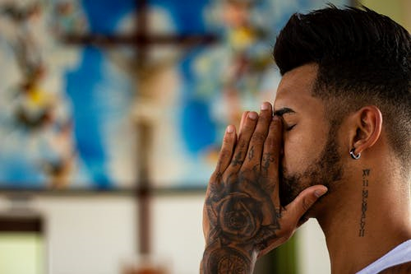
Articles
Can you guess the Human Rights?
Notes:
Students use the picture prompts to try and guess the Human Rights.

Slide 13
Articles
Healthcare
Education
Thought & expression
Religion
Fair & just law
Free from slavery
Look at these UDHR articles. Are they successful? Where are the inconsistencies?
Notes:
Students use their own knowledge to discuss how successful these are e.g. does everyone have access to healthcare? Encourage students to think about what they have seen on the news.

Slide 14
UK success? How successful is each article? Draw a line to the place on the arrow that you feel is most justified. Try to use real life examples when justifying your choice.
Notes:
A3 printed. One per group. Students draw a line to rank each right (UK) they can make notes on the paper if they wish or each group could present their ideas.

Slide 15
UK success? How successful is each article? Draw a line to the place on the arrow that you feel is most justified. Try to use real life examples when justifying your choice.
Notes:
A3 printed. One per group.

Slide 16
https://www.amnesty.org/en/countries/asia-and-the-pacific/afghanistan/report-afghanistan/
https://www.amnesty.org/en/countries/africa/botswana/report-botswana/
https://www.amnesty.org/en/countries/asia-and-the-pacific/china/report-china/
https://www.amnesty.org/en/countries/africa/eritrea/report-eritrea/
https://www.amnesty.org/en/countries/africa/sierra-leone/report-sierra-leone/
Global success?
You will now work in 5 groups. Each group will look at a different report, creating a brainstorm highlighting how successful/unsuccessful the UDHR has been in that particular country. You will then feedback to the rest of the class.
Notes:
Hyperlinked to printable mini reports. Each group looks at a different country and summarises what is happening. If they can, they should link back to the articles that have been introduced so far.

Slide 17
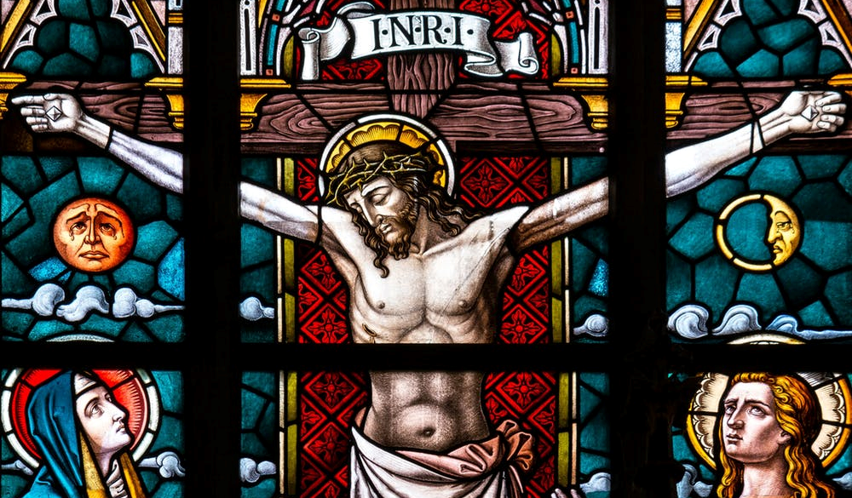
Christian perspective – Human Rights
Christians believe that all humans are made in the image of God and therefore should have equal opportunities and the same rights. They also believe that all life is special as it belongs to God so the ‘right to life’ is a fundamental Christian belief. Freedom of thought and expression is also very important so that Christians can share their beliefs with others and meet to worship.

Slide 18
Christian perspective – Human Rights (challenges)
Some Christians believe that homosexuality is a sin and therefore might struggle with the right to family (civil partnerships/gay marriage)
Some Catholics may struggle with the concept of equal rights in religion (in terms of sex/gender) as this may be in conflict with what they believe the correct role of males and females within the Catholic church should be.
Notes:
These points can be debated.

Slide 19
The UK is viewed as being a follower of Human Rights. In 1998 the Human Rights Act was passed, turning human rights into legal rights. If UK citizens feel as though their basic human rights are being denied, they have the right to take the alleged offender to court.
Therefore…
Should religious leaders do more to promote Human Rights?
Notes:
Pose this question to the students.

Slide 20
Should citizens do more to promote Human Rights?
How can you support Human Rights?
Notes:
Encourage students to brainstorm, discuss.

Slide 21
I am a supporter of Human Rights
Personal
On an individual level, I will
National
As someone who lives in the UK, I will
Global
As a global citizen, I will
Notes:
Students that have a range of ideas can fill in this sheet (A4 printed)

Slide 22
I am a supporter of Human Rights
Personal
On an individual level, I will
Notes:
Students that have ideas limited to PERSONAL can fill in this (A4 printed)

Slide 23
I am a supporter of Human Rights
National
As someone who lives in the UK, I will
Notes:
Students that have ideas limited to NATIONAL can fill in this (A4 printed)

Slide 24
I am a supporter of Human Rights
Global
As a global citizen, I will
Notes:
Students that have ideas limited to GLOBAL can fill in this (A4 printed)

Slide 25
Ideas and suggestions
Global
Be globally informed by reading/watching the news
Lobby your MP about global Human Right concerns
Look on https://www.amnesty.org.uk/get-involved to find out how you can get involved
Ask your headteacher if you can organise a Global Rights information stall
Personal
Think about my responsibilities in relation to rights e.g. not impacting people right to an education.
Treating people equally and with respect
Following the law.
Not being a bystander
Educate my friends/family about the UDHR
National
Joining national social media groups/following #HumanRights to be better informed
Researching the Human Rights Act 1998 to be better informed
Lobby your MP about Human Rights issues that concern you
Educate others about the Human Rights Act
Notes:
Teacher support and/or resource to encourage ideas and suggestions for final activity.

