Slide 1
Learning from

Slide 2
We will spend form time looking at 4 case studies.
If you watch Love Island, you will recognise them.
If you don’t watch it, you will still be able to join in with the discussion.

Slide 3
Sophie and Connor are coupled up with each other.
They have not been together very long.
Connor gets very jealous when Sophie makes friends with new boys. He knows that lots of boys will fancy Sophie and this makes him angry.
Is jealousy normal in a romantic relationship?
Would you expect to see jealousy in a healthy romantic relationship?
Why might jealousy be toxic for a relationship?

Slide 4
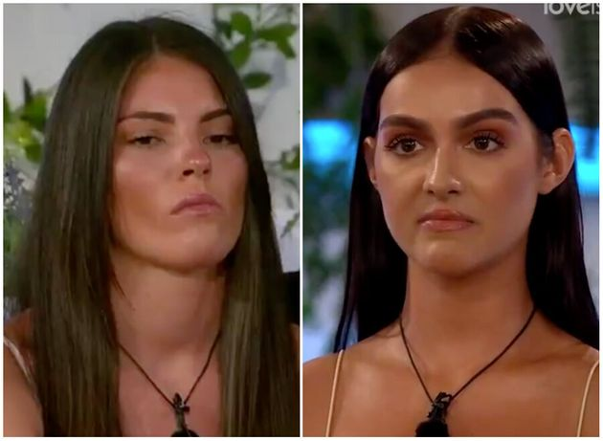
Rebecca and Siannese have only been friends for a short while. They have a problem where they keep fancying the same boy.
Siannese thinks that Rebecca should follow ‘girls code’ and not pursue someone that she also fancies. Rebecca thinks that because they have only been friends for a short while, it isn’t a problem and they should both be free to do what they want.
What do you think Siannese means by ‘girl code?’ Is there such thing as ‘boys code?’
Should friends ever let a romantic relationship stand in the way of friendship?
What’s more important, having a boyfriend/girlfriend or having a best friend?

Slide 5
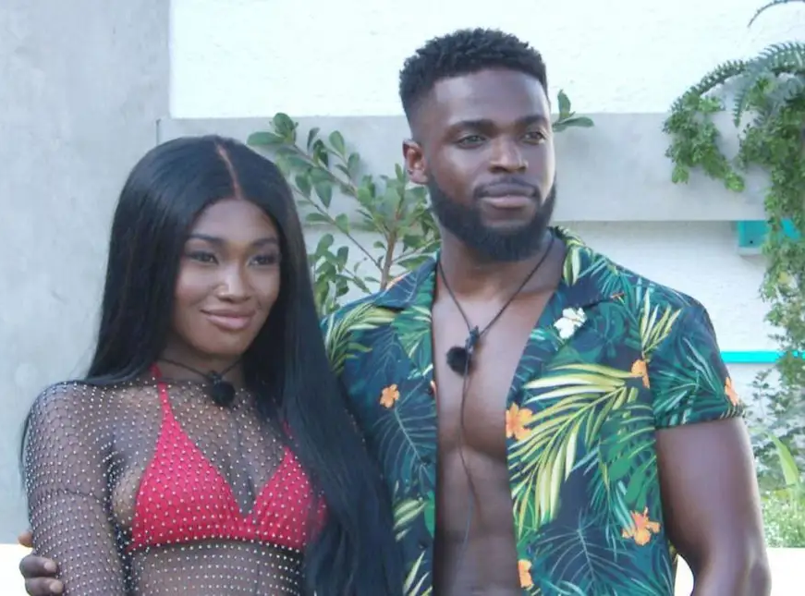
Leanne and Mike are coupled up. They have not been together very long. Mike feels more for Leanne than Leanne feels for Mike. She is starting to get annoyed with him because he is making her feel ‘suffocated’. Mike isn’t aware of this.
Why is it important to ‘take your time’ with a new romantic relationship?
Why might someone feel ‘suffocated’ in a romantic relationship?
Should Leanne talk to Mike about how she feels? What might the impact of this be?

Slide 6
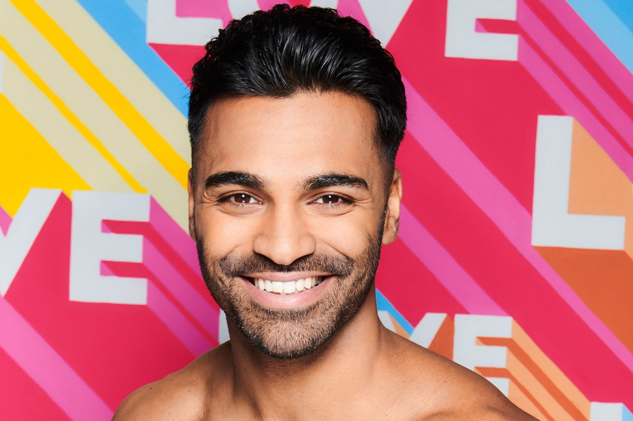
Nas is an intelligent, well educated 23 year old from London. All of his friends love him and think he is really funny and kind. However, Nas is struggling to find a girlfriend.
Girls that meet him say they don’t fancy him, some have said this is because he is ‘too short’ others have said that he is ‘too nice’.
Why might some people make judgements based on looks?
Why might some people view being ‘too nice’ as a negative thing?
Which sex gets judged more for how they look, men or women?

