Slide 1
What is identity?
Starter – what does identity mean to you?

Slide 2
If you had been asked the question, who are you? At 5 years old, what would you have said?
5
Who are you?
Notes:
Encourage students to reflect back to when they started school. Who were their friends? What were their hobbies? etc

Slide 3
Who are you? How would you answer this question now?
Who are you?
Notes:
Encourage students to think about who they are now. This is their identity. How would they describe themselves?

Slide 4
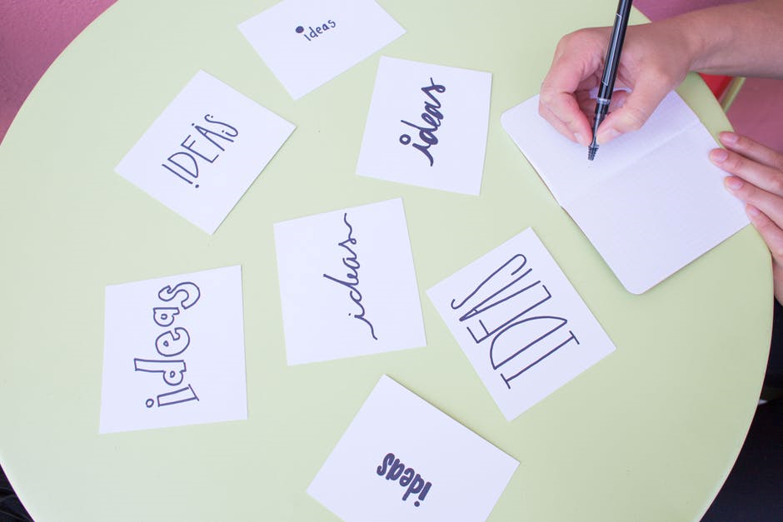
Work in groups to create a brainstorm, highlighting all of the different factors that shape peoples identity e.g. religion.
Notes:
Encourage students to think about a full life span, not just teen years. For example parent, career etc. It might be useful for the teacher to share aspects of their identity if they feel comfortable.

Slide 5
Age | Locality | Nationality | Ethnicity
Religion/moral beliefs | Job (future) | Personality | Family
Friends | Clubs/groups | Hobbies | Appearance
Notes:
This should be printed out A3 for students to complete. They may need some terms explaining. Ensure this is completed in a safe environment, students should be given the option to opt out of some if they need and for ethnicity/nationality there may be some confusion/differences. Once complete, it is nice for students to read each others work (if comfortable) or sheets can be placed around the room for students to ‘guess’ the person.

Slide 6
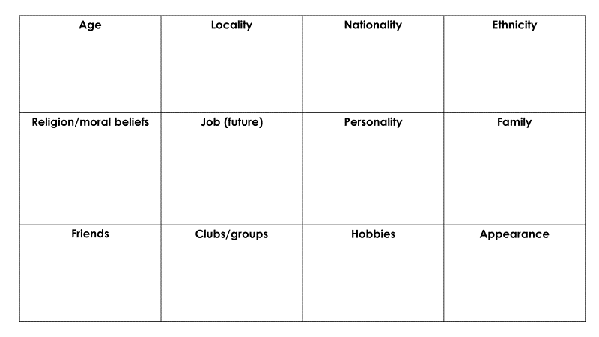
 | *** is the most important because
 | *** is the least important because
My opinion is similar/different to my friend/peer because…
Challenge - People will have different opinions about this because…
Notes:
This activity can be completed verbally or in workbooks if used. Discussion should highlight how life experiences and beliefs will determine how important certain factors are e.g. a white person who has never experienced racism may not determine race as important compared to someone of ethnic minority who has experienced racism. It is nice to share opinions once complete, if students are comfortable.

Slide 7
My identity
Notes:
Final reflection – slide printed out A4, students reflect in the lesson and use this reflection to write a statement or paragraph describing/explaining their identity.

